Slide 1
The Status and Performance
of the
CMS Pixel Detector
Souvik Das
Cornell University
on behalf of the CMS Pixels team
Contents
Pixel Detector Hardware
Pixel Data Acquisition Software
Installation & Quick Checkout
Commissioning – some Calibrations
Cosmic Data Taking
Pixel Noise and Thresholds
Charge Collection Data
Results of Alignment with Cosmic Rays
12 March 2009

Slide 2
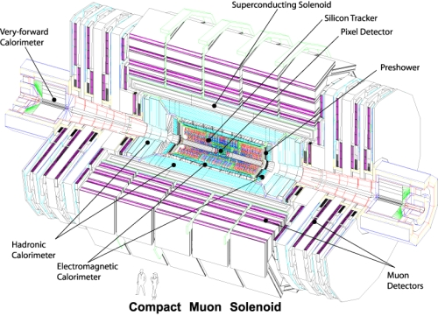
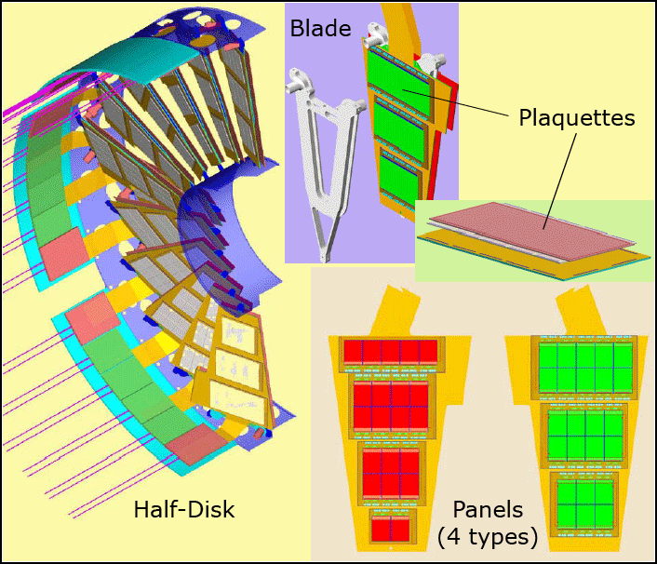
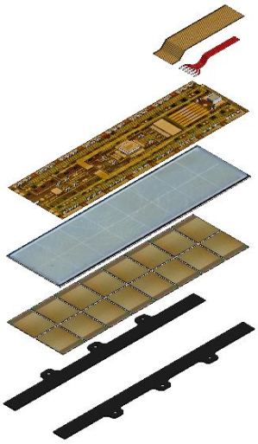
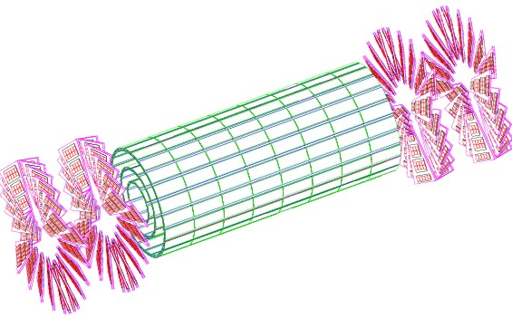
The Pixel Detector in the Compact Muon Solenoid
Panels of the Forward Pixel Detector
Forward Pixel Detector (FPix) has two disks on each side at 34.5 cm and 46.5 cm
FPix has 672 modules
Barrel Pixel Detector (BPix) has 3 layers of radii 4.3 cm, 7.2 cm and 11.0 cm
BPix has 768 modules
Total of ~15,840 Readout Chips
The CMS Pixel Detector
53 cm
93 cm
65 mm
Modules of the Barrel Pixel Detector
Notes:
Where the BPix and FPix fit into CMS

Slide 3
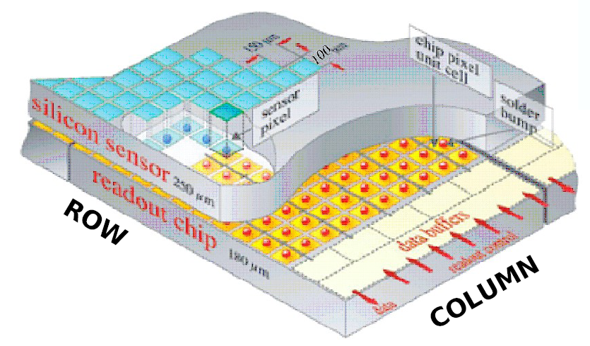
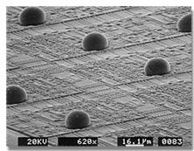
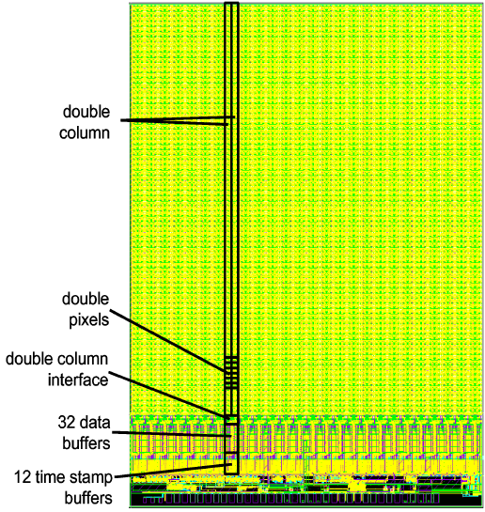
The Pixel Sensor and the Read Out Chip
ReadOut Chip (ROC) bump bonded sensor pixels.
52 × 80 = 4160 pixels per ROC
15,840 ROCs
66 million pixels
Automatic zero-suppression
Each pixel has a programmable threshold (adjusting this is called trimming)

Slide 4
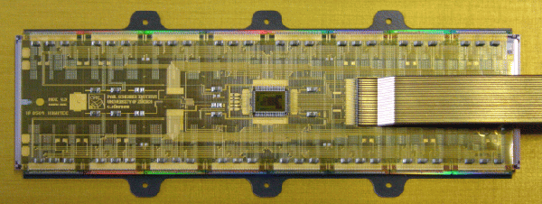
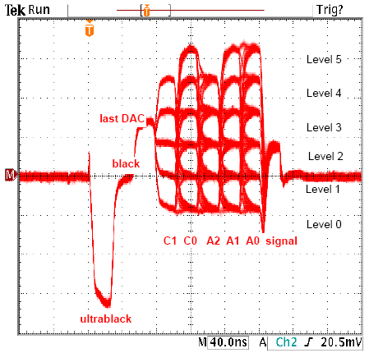
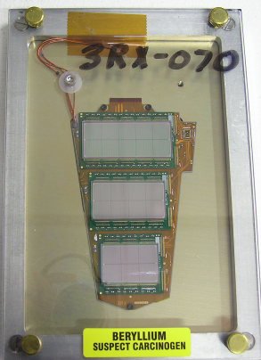
Forward and Barrel Pixel Analog Readout
On receiving a L1 trigger, the Token Bit Manager (TBM) initiates a Chinese-whisper of “token bits” that instruct each ROC to send its hit data to the TBM
The signal from the TBM is electrical and analog. It encodes the ROC #, row and column and charge deposit of each pixel hit
The electrical signal from the TBM is converted to optical by the Analog-Optical Hybrid (AOH)
Poster of J. C. Yun “Readout System of the CMS Pixel Detector” for details.
Notes:
BPix and FPix readout scheme showing analog readout scheme that must be digitized

Slide 5
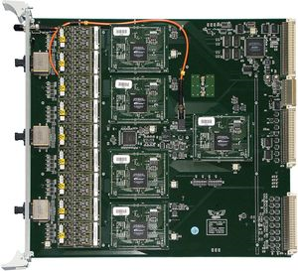
Digitization of Analog Readout with the Front End Driver
PixelFEDSupervisor
DAQ
Pixel Front End Driver (FED) digitizes analog signals given the level thresholds for decoding.
One crate of FED boards is controlled by one PixelFEDSupervisor application. 40 FEDs in Pixels.
FEDs send digitized data down S-Link cables to the Data Acquisition System (DAQ).
FED data may also be read out via VME by the PixelFEDSupervisor.
Notes:
TBM to opto-hybrid sends analog data to FED which digitizes it and sends it to the Slink. A crate of FEDs is controlled by a PixelFEDSupervisor XDAQ Application. What can the application do?

Slide 6
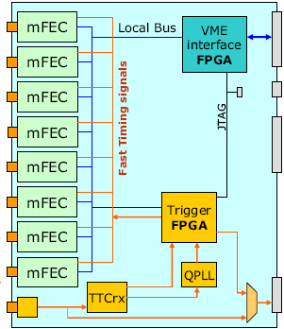
Barrel and Forward Pixel Programming Chain
PixelFECSupervisor
Control signals consist of
Clock & L1 Trigger
I²C Commands for programming
Using I²C commands we can program various DACs on each ROC, set trim bits on each pixel and inject charges for calibration purposes.
Poster of J. C. Yun “Readout System of the CMS Pixel Detector” for details.
Notes:
BPix and FPix programming chain. The PixelTKFECSupervisor and PixelFECSupervisor XDAQ applications are used to program them.

Slide 7
Pixel Data Acquisition Software
Pixel
Supervisor
Pixel
Configuration
Database
Output
Disk
CTC
AFS R/W
AFS R/W
AFS R/W
Trigger Throttling System Lines
SOAP Messages
Trigger
Central
CMS
DAQ
Pixel
TKFEC
Supervisor
Pixel
FEC
Supervisor
Pixel
TTC
Supervisor
TkFEC
TkFEC
FEC
FEC
FEC
TTCci
Pixel
FED
Supervisor
FRL
FRL
FRL
Fast I²C Signals
Slow I²C Signals
Portcard
CCU
Trigger
FED
FED
FED
S-Links
Pixel
Detector
Optical Links
Notes:
Entire Pixel Online Software structure in stages

Slide 8
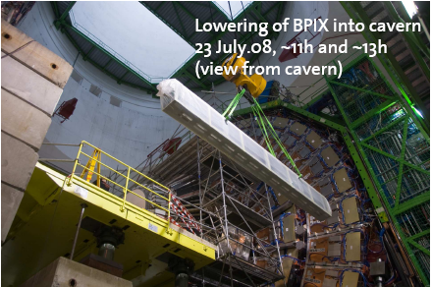
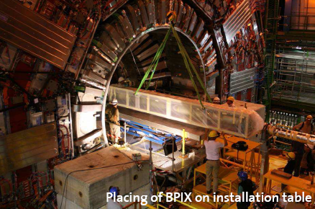
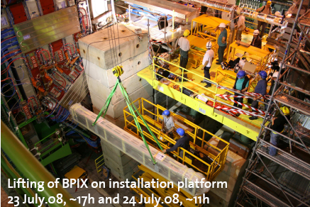
Lowering the Barrel Pixels into the Cavern

Slide 9
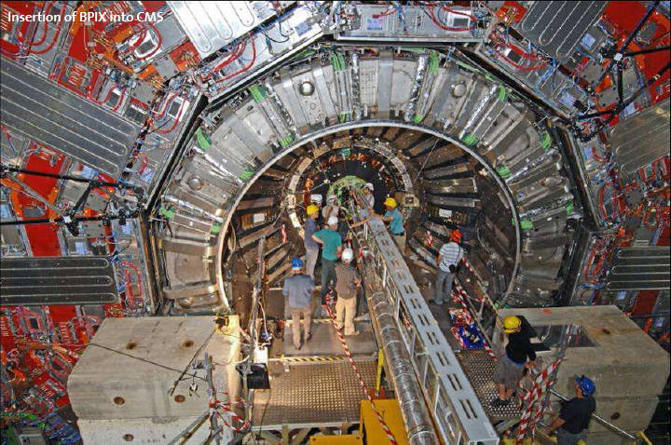
Inserting the Barrel Pixels into CMS
Notes:
Tuesday 29th July Insertion of FPix minus complete
Thursday 31st July FPix positive is in
Connected all power cables, fibers and cooling pipes
Checked cooling pipes for leaks
Turned on one module at a time to ensure correct mapping of the power cables, control and data fibers, temperature readouts.

Slide 10
Quick Checkout of the Barrel Pixels
The BPix was lowered into the cavern on 23 July 2008
Installed cooling, power cables, optical fiber connections
Quick Checkout using standalone software developed at PSI was used to quickly check communication with the BPix. The following were tested:
Clock and trigger distribution.
Front end programmability
Quality of readout Signals
Bias connections.
Done by 29 July 2008
FPix given the green light for installation
1 week

Slide 11
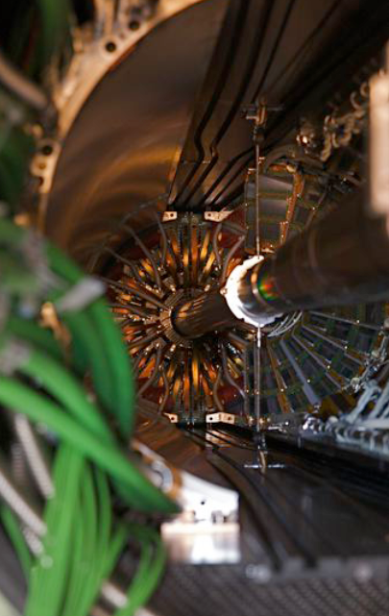
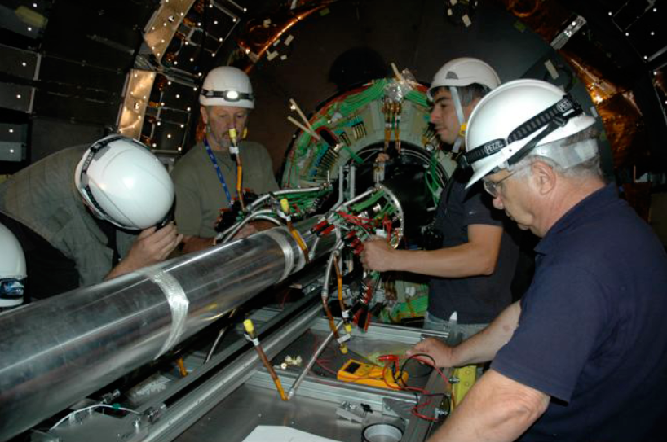
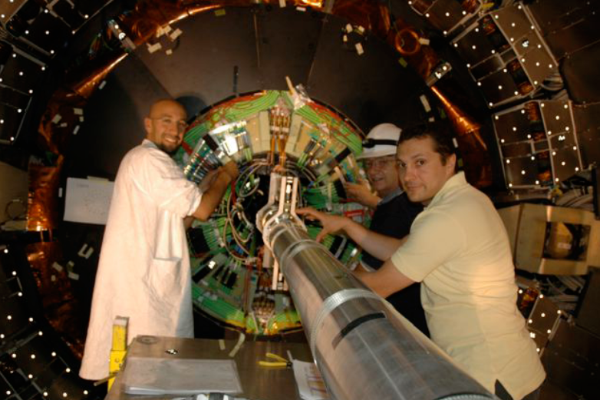
Inserting the Forward Pixels into CMS
Cabling and cooling after insertion
The FPix being slid in with the BPix in place.
Synchronous insertion of the inner and outer half-cylinders.
Notes:
Tuesday 29th July Insertion of FPix minus complete
Thursday 31st July FPix positive is in
Connected all power cables, fibers and cooling pipes
Checked cooling pipes for leaks
Turned on one module at a time to ensure correct mapping of the power cables, control and data fibers, temperature readouts.

Slide 12
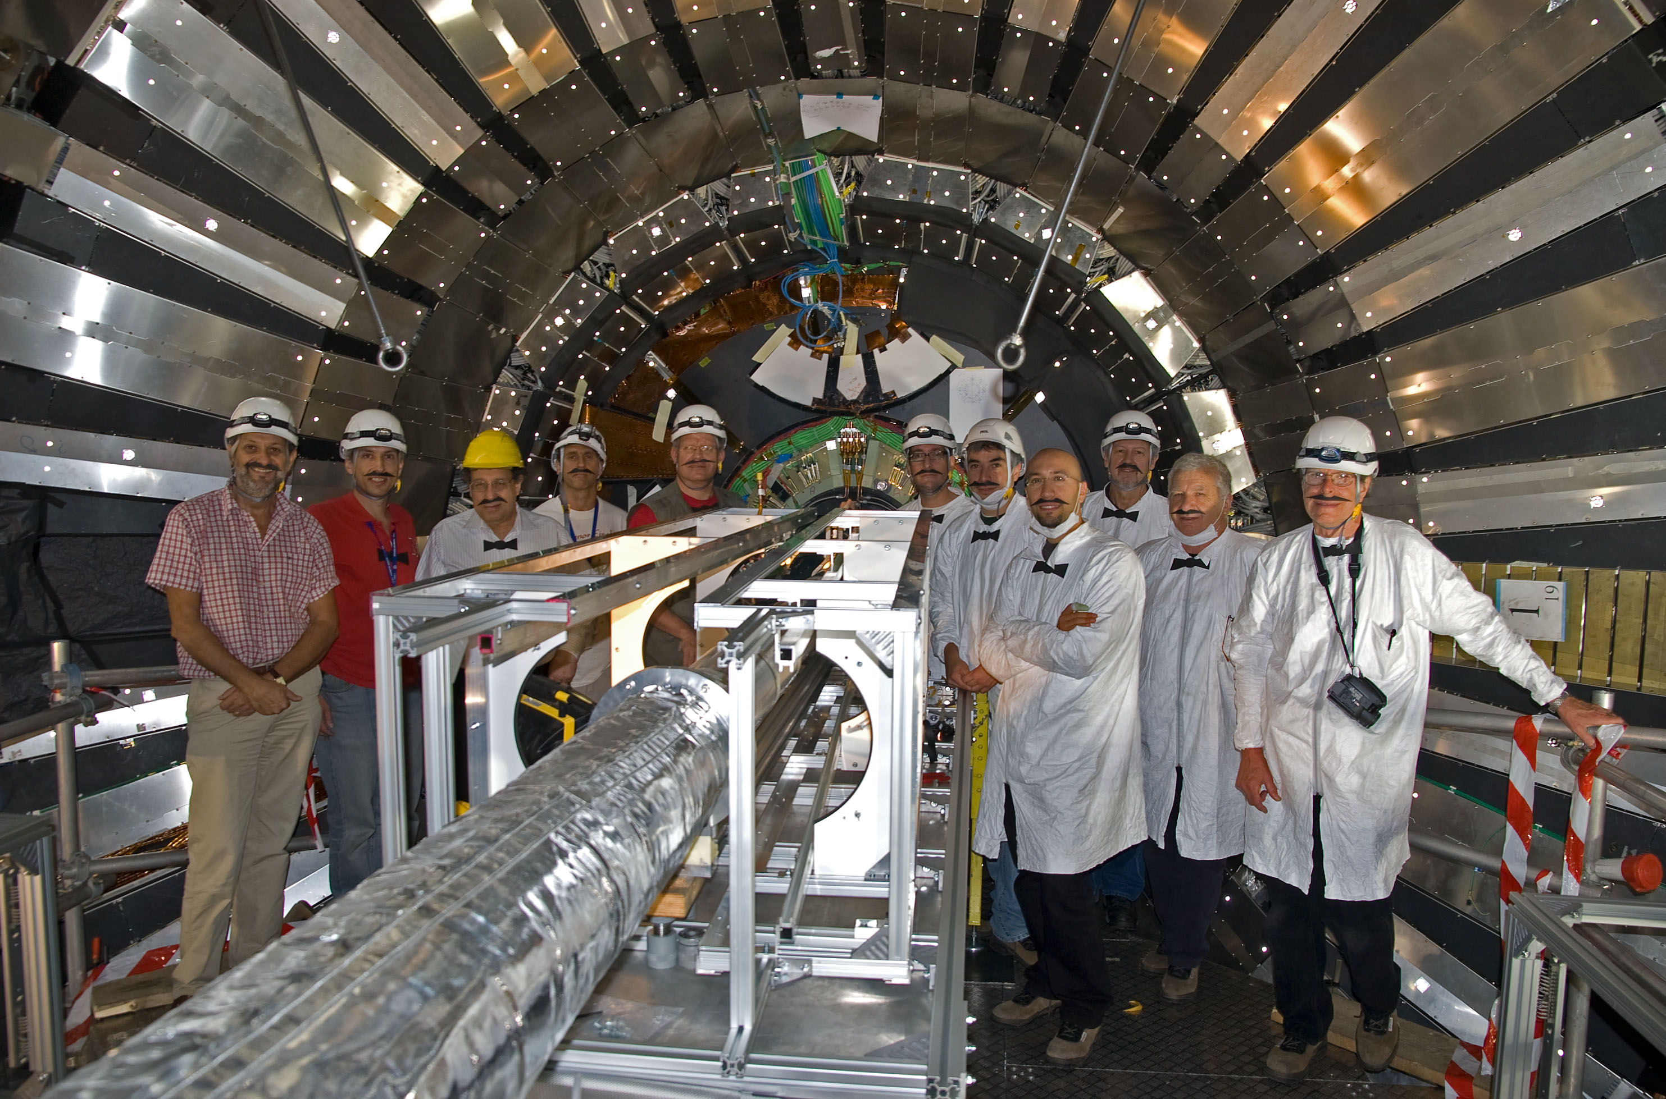
Viola, Monsieur!

Slide 13
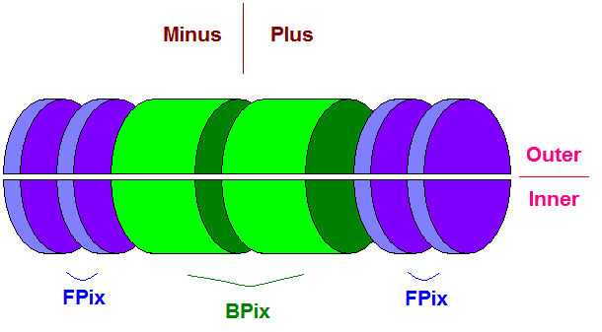
Quick Checkout of the Forward Pixels
FPix services connected by 31st July 2008
Quick Checkout using Pixel Data Acquisition Software one Half Cylinder at a time:
Ensure correct mapping of the data fibers
Appropriate change of drawn current on configuring the Readout Chips
Stable baseline of the TBM analog signal (FEDBaselineCalibration)
Some panels required cleaning of the optical fiber. Baselines stabilized.
CMS Pixel Detector closed on 7th August 2008
1 week
Notes:
Why a quick checkout? Because the pixel volume needed to be closed and platform evacuated.
The FED Baseline’s RMS value was used to detect dirty fibers.

Slide 14
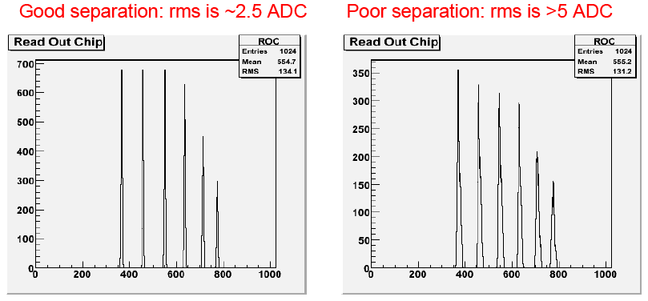
Address Levels Calibration during Second Commissioning Phase
Address Levels Calibration
For the FED to decode the analog output of the TBM, it must know the address level thresholds.
Address level peaks may get smeared out when:
The FED samples the signal at the wrong time
The baseline is jittery due to unclean optical fibers
The analog signal from the TBM
Notes:
Why phase 2? Because the BCM needs to close on us once we’re done. The beampipe supports need to e

Slide 15
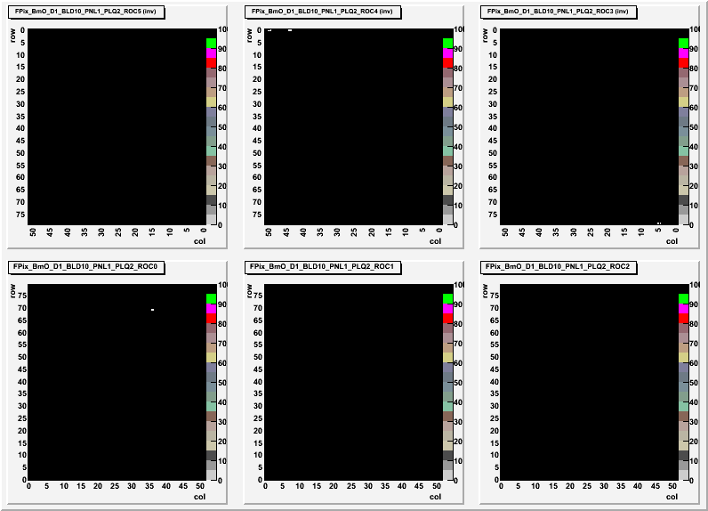
Pixel Alive Scan during Second Commissioning Phase
Pixel Alive
Inject charge repeatedly into each pixel and see how often they respond.
Build up an efficiency map and identify defective pixels.
Dead Pixels
0.010% of BPix
0.015% of FPix

Slide 16
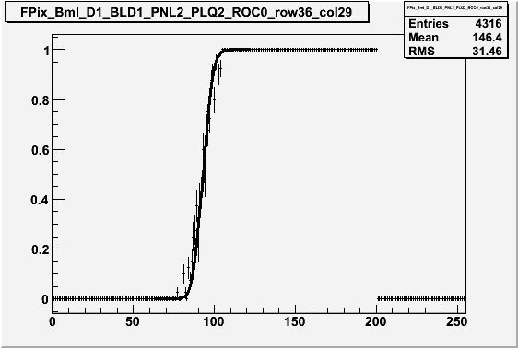
S-Curve Calibration during Second Commissioning Phase
S-Curve Calibration
The charge injected into each pixel for calibration, governed by VCal, is varied.
The efficiency of pixel response against the change in VCal gives us an S-Curve
width
Efficiency
mean
VCal
The VCal corresponding to 50% efficiency is the threshold of response.
The width of the turn-on region is a measure of the pixel’s noise.
One unit of VCal is roughly 65 electrons.

Slide 17
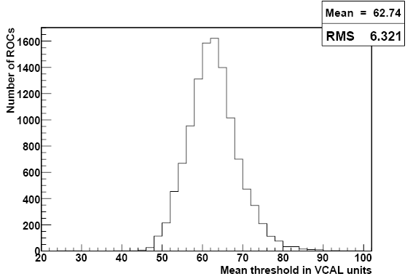
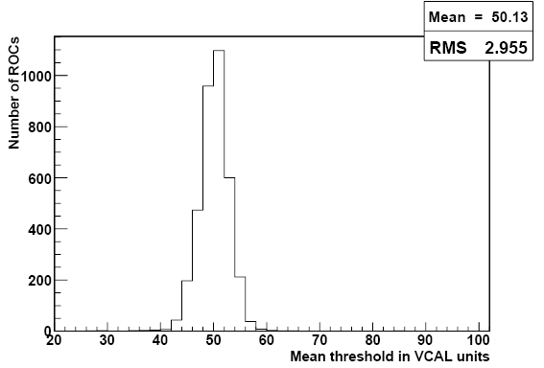
Pixel Thresholds from S-Curves during Second Commissioning Phase
Threshold distribution for un-trimmed Barrel Pixels.
Mean corresponds to ~3690 e⁻
Threshold distribution for trimmed Forward Pixels.
Mean corresponds to 2870 e⁻
Threshold well below the minimum ionizing particle ~22,000 e⁻

Slide 18
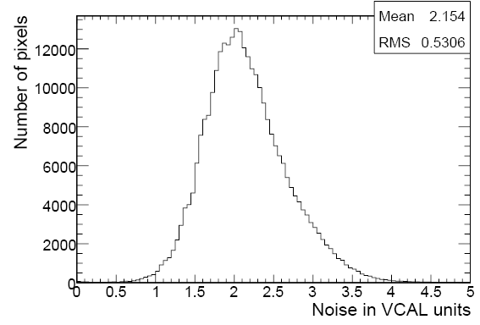
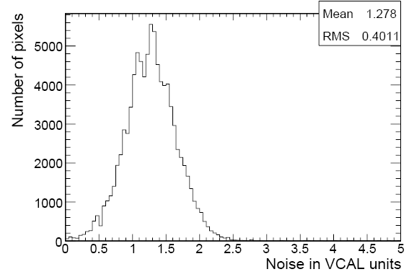
Pixel Noise from S-Curves during Second Commissioning Phase
Noise distribution for the Barrel Pixels.
Mean corresponds to 141 e⁻
Noise distribution for the Forward Pixels.
Mean corresponds to 85 e⁻
Level of noise does not significantly degrade response of the detector

Slide 19
Results of the Second Phase of Commissioning
Physical access to the Pixel Detector lost on the 7th of August 2008
In the FPix, 260 ROCs are not performing. 6% of the FPix is out of action
(135 ROCs shorted digital voltage, 101 ROCs lost bias voltage, 24 ROCs have low signal)
In the BPix, 100 ROCs are not performing. 0.87% of the BPix is out of action
Of the remaining FPix pixels, 0.015% are dead and masked out
Of the remaining BPix pixels, 0.010% are dead and masked out
0.0005% of the pixels are masked out as noisy
The integration between DAQ and DCS required for semi-automatic power-up was tested and established as conventional procedure.
The FPix participated in a mid-week global run on the 13th – 14th of August 2008
FPix roughly time-aligned with cosmics
FPix and BPix functioned as one detector under CMS Run Control between18th – 25th of August 2008 (CRUZET 4)
1 week
4 days

Slide 20
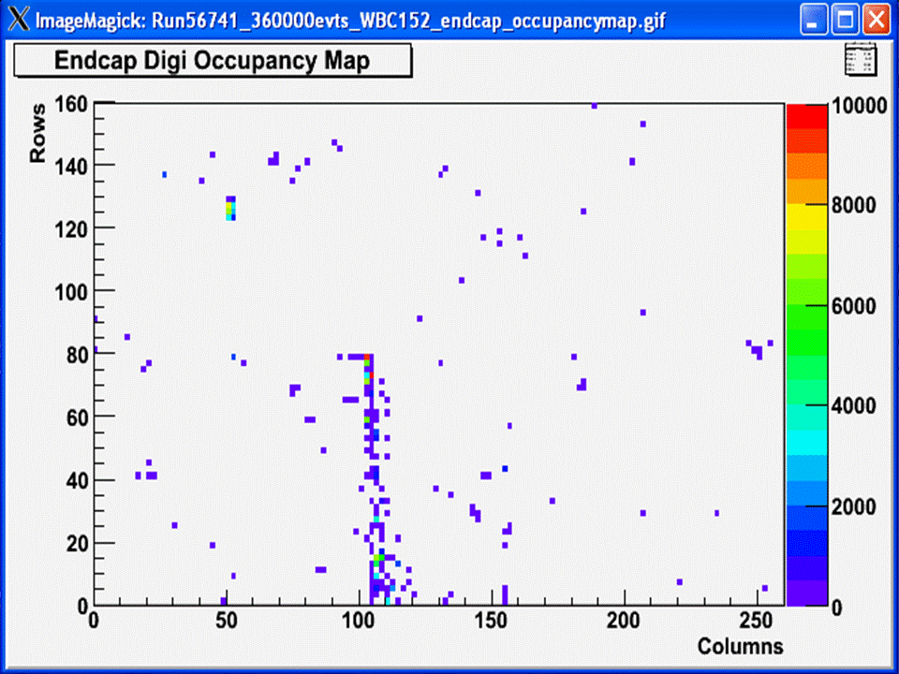
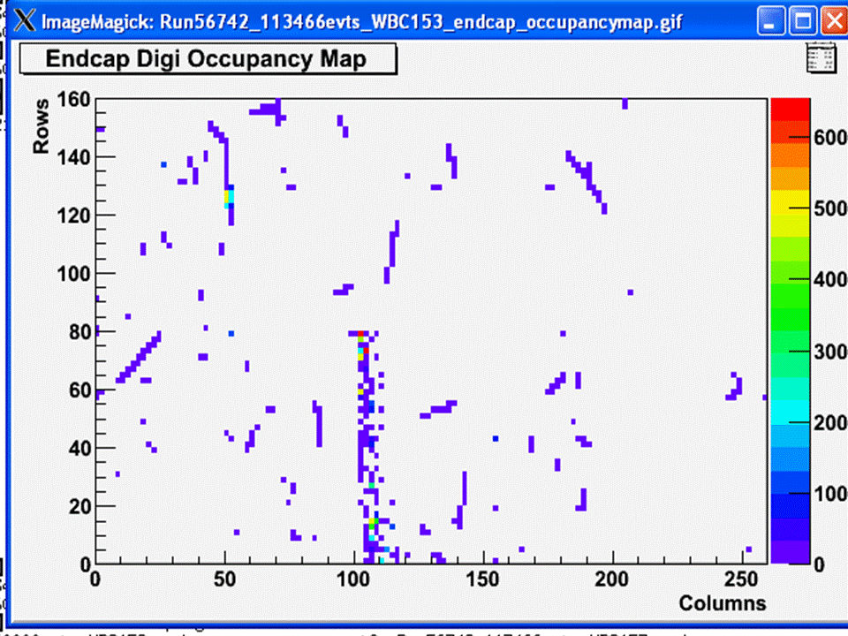
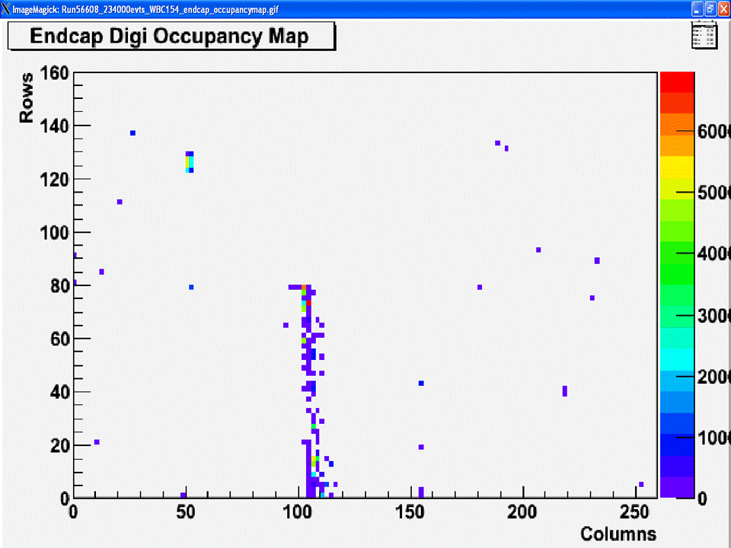
Time Alignment in the Third Phase of Commissioning & Global Run
The Final Stage of
Time Alignment in
the FPix with
Cosmics
Misaligned
(No Tracks)
Aligned →
(Tracks!)
Misaligned
(No Tracks)
Hot pixels at the edge of a module

Slide 21
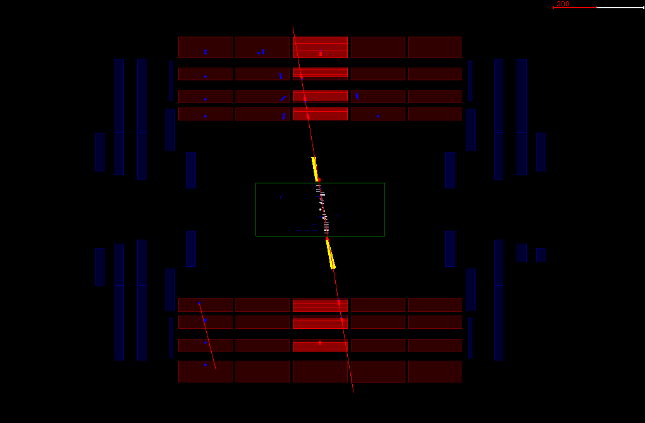
Muon goes through CMS at Cosmic Run at Zero Tesla

Slide 22
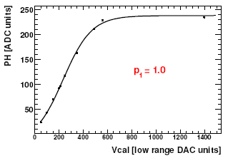
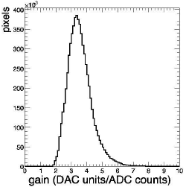
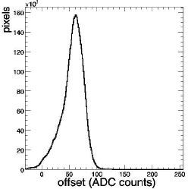
Gain Calibration
Gain Calibration
The charge injected into each pixel for calibration, governed by VCal, is varied.
The pulse height in ADC counts plotted against the VCal gives us the Gain Curve
Linear fit between the Pulse Height read out by the FED and the charge in VCal units or electrons it represents.
Mean of slope = 3.6 (DAC/ADC)
Offset = 55 ADC
Used for calculating charge deposited in clusters (position average)

Slide 23
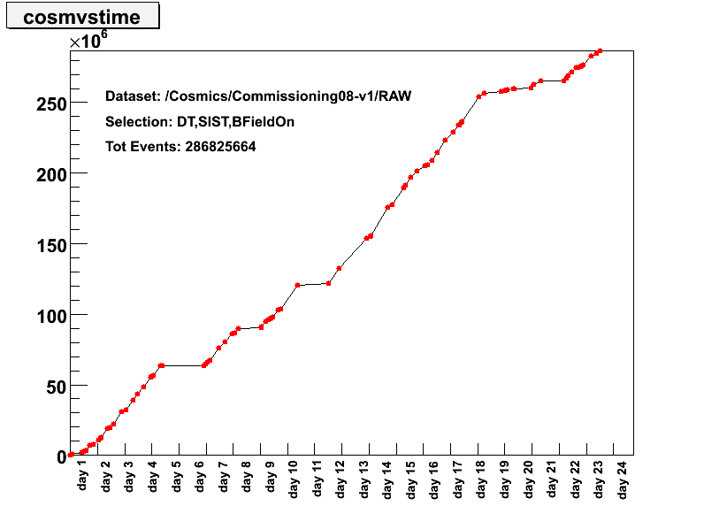
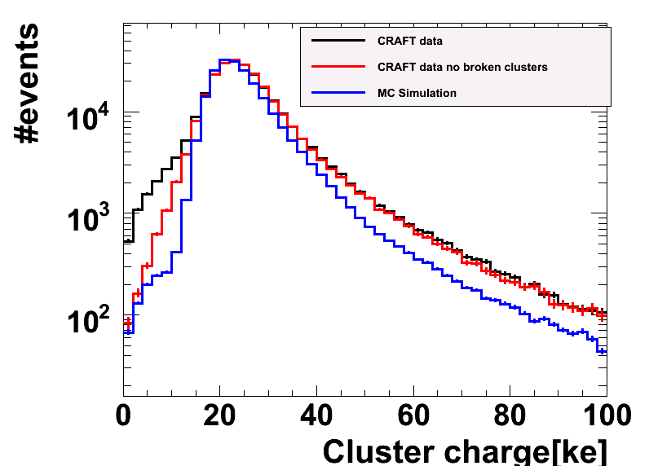
Charge Collection with Cosmic Muons
CRAFT (Cosmic Run at Four Tesla) at 3.8 T took about 370 million events.
80,000 tracks recorded through the Pixel Detector
Cluster charge normalized to 285 μm gives a Landau distribution with peak at ~ 22,000 e⁻
Barrel Pixels

Slide 24
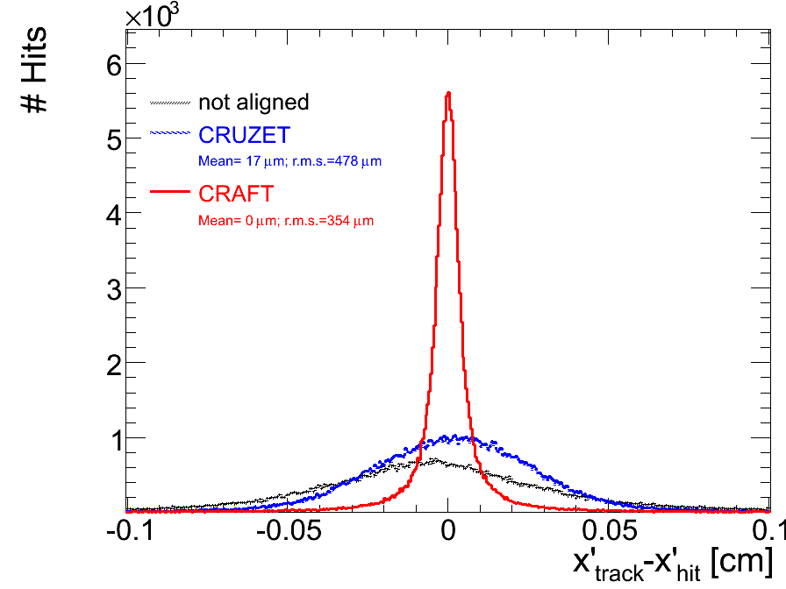
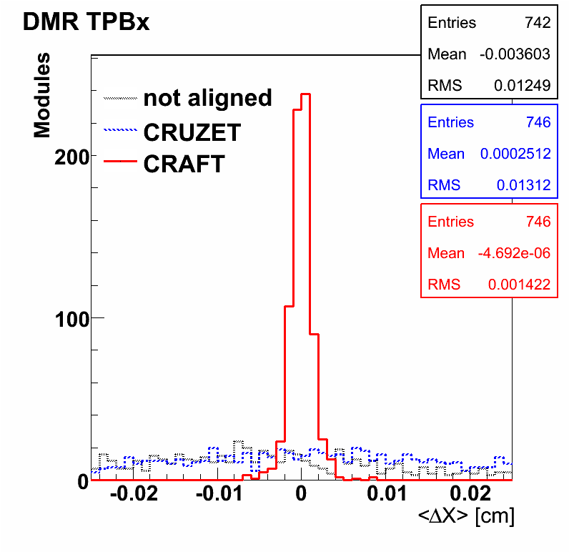
Track Quality after Alignment with Cosmic Muons
CRUZET = Alignment with Cosmic Run at Zero Tesla
CRAFT = Alignment with Cosmic Runs at Four (3.8) Tesla
Residual = Distance between expected hit and reconstructed hit
DMR = Distribution of Median of Residuals
Barrel Pixels x-residuals
Design Resolution of 10 μm
DMR RMS is 14 μm

Slide 25
Conclusions
The CMS Pixel Detector was installed successfully within a very tight schedule (days!)
Commissioned in two weeks
Participated in Cosmic Run at Zero Tesla (CRUZET 4) as one detector.
Participated in Cosmic Run at Four Tesla (CRAFT 3.8 T) as one detector. Data collected is being used for performance studies and alignment.
6% of the Forward Pixel Detector is damaged. It is being taken out and repaired over the 2008-2009 winter shutdown.
Should be optimally ready for data taking in Spring 2009

Slide 26
Backup Slides

Slide 27
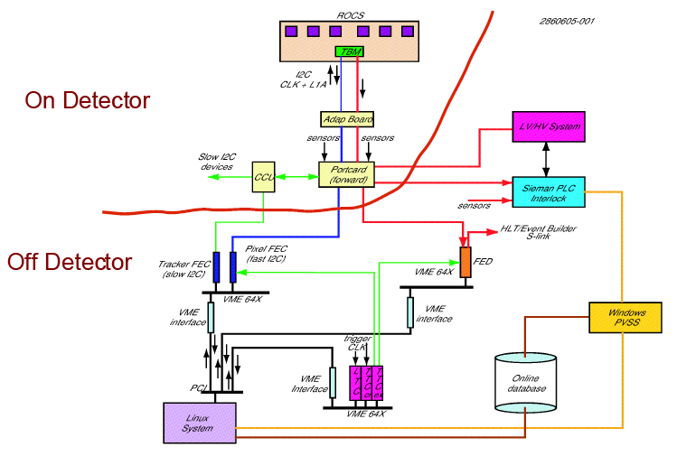
Pixel Control and Readout

Slide 28
Pixel Online Software within the Run Control Framework
Level Zero
Function Manager
Level Zero Function Manager is the CMS Shifter’s GUI. It learns from the Resource Service DB to instantiate a Pixel Function Manager.
Pixel Function Manager reads from Resource Service to instantiate PixelSupervisor and other XDAQ applications
PixelSupervisor retrieves from Pixel Configuration Database the hardware settings
Resource Service
Database
Pixel
Function Manager
Pixel
Configuration
Database
Pixel
Supervisor
Pixel
FED
Supervisor
Pixel
TKFEC
Supervisor
Pixel
FEC
Supervisor
Pixel
TTC
Supervisor
Pixel
FED
Supervisor
Pixel
TKFEC
Supervisor
Pixel
FEC
Supervisor
Pixel
TTC
Supervisor
Pixel
FED
Supervisor
Notes:
… and how it fits into the CMS Online Software framework

Slide 29
Finite State Machine Structure of PixelSupervisor
Initial
Initialize
Configuring
Start
Pause
Configure
Halted
Configured
Running
Paused
Halt
Stop
Resume
Halt
Stop
TTS
Test Mode
Halt

Slide 30
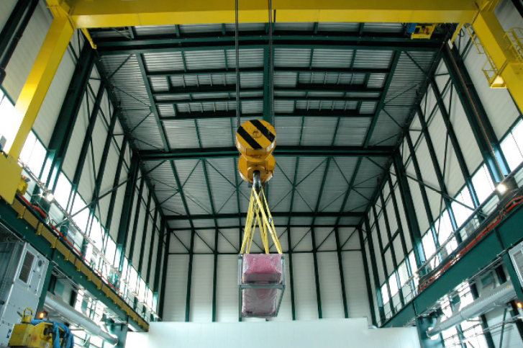
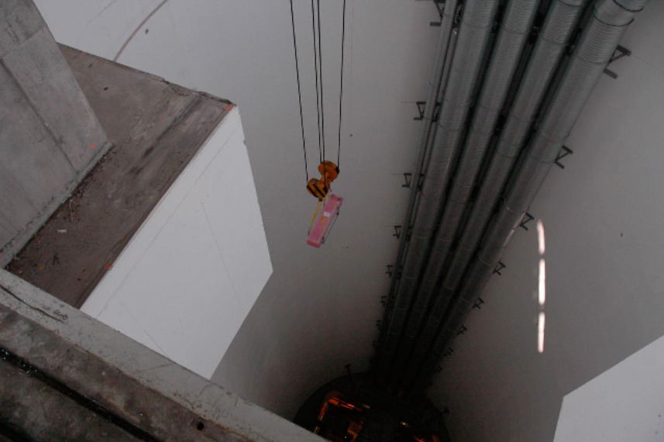
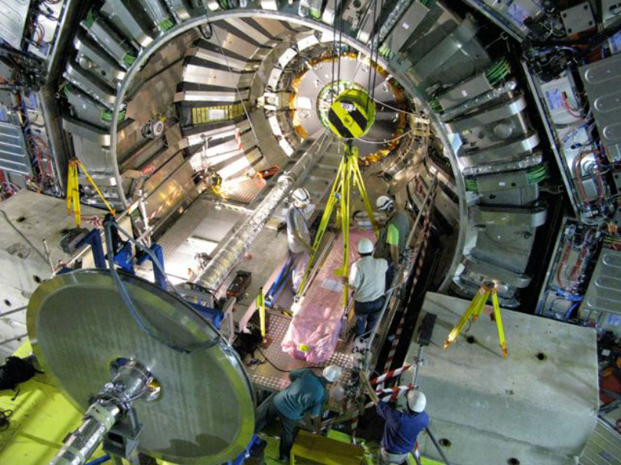
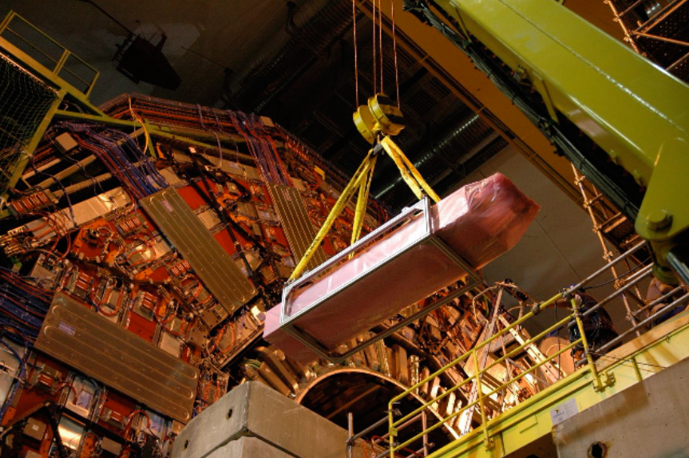
Lowering the Forward Pixels into the Cavern

Slide 31
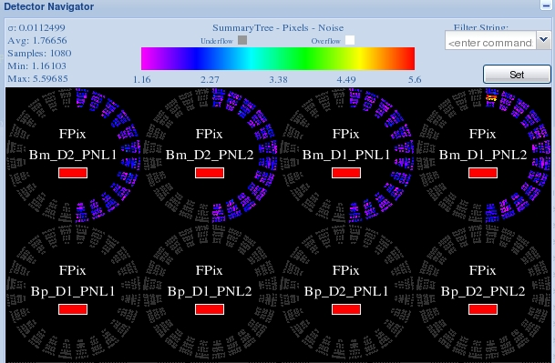
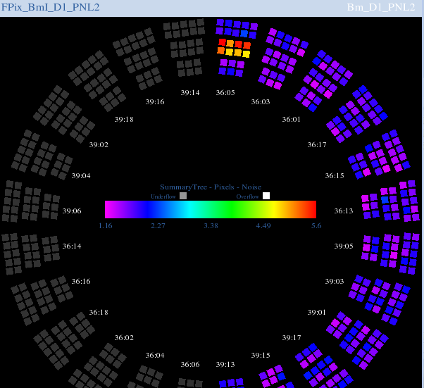
Commissioning Phase II – S-Curve Calibration
An S-Curve Showing the Broken High Voltage Wirebond
BmI_D1_PNL2 had been noted through inspection to have a broken high-voltage wirebond

Slide 32
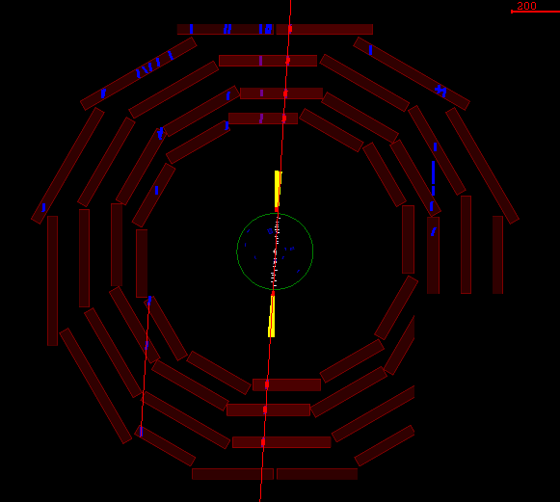
Cosmics in CRUZET 4

Slide 33
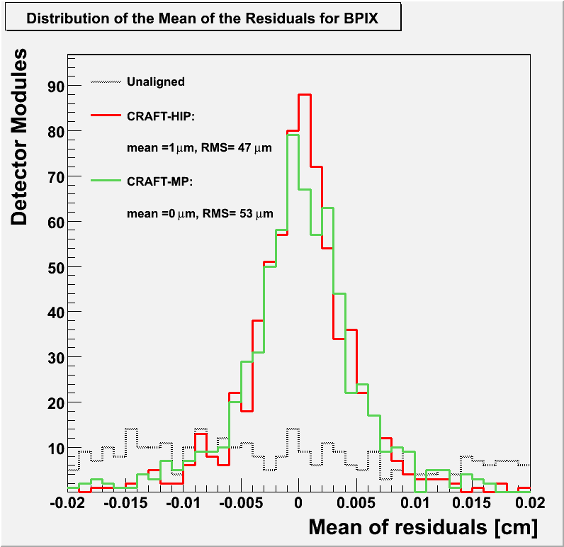
Track Quality after Rough Alignment
Barrel Pixels aligned at module level
Unaligned is the nominal geometry
CRAFT-HIP and CRAFT-MP are two alignment algorithms applied to the CRAFT data
Significant narrowing of track residuals

Slide 34
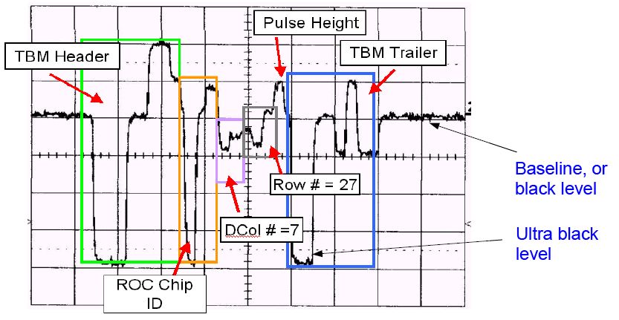
Commissioning Phase II – Address Levels Calibration
Address Levels Calibration
For the FED to decode the analog output of the TBM, it must know the address level thresholds.
Address level peaks may get smeared out when:
The FED samples the signal at the wrong time
The baseline is jittery due to unclean optical fibers
The analog signal from the TBM
Notes:
Why phase 2? Because the BCM needs to close on us once we’re done. The beampipe supports need to e

Slide 35
Charge Collection
CRAFT (Cosmic Run at Four Tesla) at 3.8 T took about 370 million events.
80,000 tracks recorded through the Pixel Detector
Cluster charge normalized to 285 μm gives a Landau distribution with peak at ~ 22,000 e⁻
Barrel Pixels

Slide 36
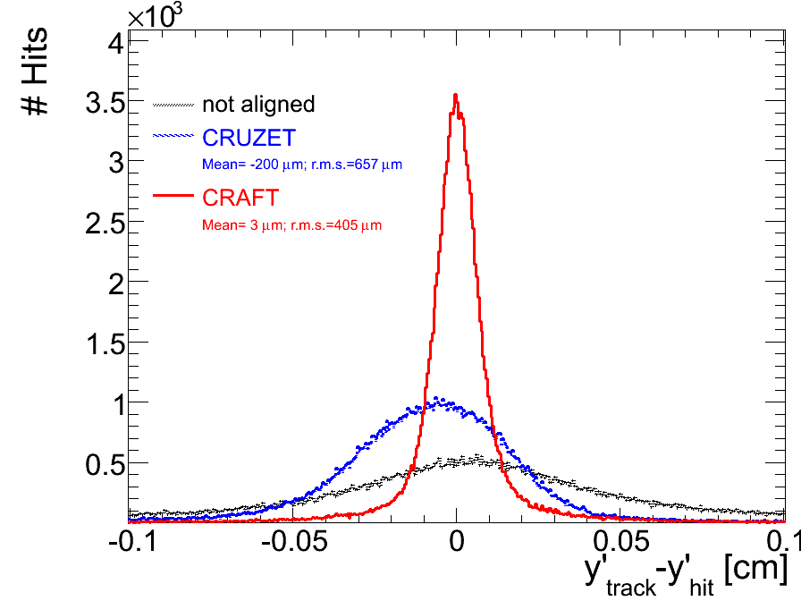
Track Quality after Alignment with Cosmic Rays
CRUZET = Alignment with Cosmic Run at Zero Teslas
CRAFT = Alignment with Cosmic Runs at Four (3.8) Teslas
Barrel Pixels y-residuals

Slide 37
Track Quality after Alignment with Cosmic Rays
CRUZET = Alignment with Cosmic Run at Zero Teslas
CRAFT = Alignment with Cosmic Runs at Four (3.8) Teslas
Forward Pixels x-residuals

Slide 38
Track Quality after Alignment with Cosmic Rays
CRUZET = Alignment with Cosmic Run at Zero Teslas
CRAFT = Alignment with Cosmic Runs at Four (3.8) Teslas
Forward Pixels y-residuals

